Slide 1
2019 March Data Crunch Madness Case Competition
Fordham University – Team Basketball Aftershocks
Team Members
Boyin Zhu
Elsa Ho
Hayley Teng
Vince Yao Jing
PROBLEM STATEMENT
METHODOLOGY
DATA COLLECTION AND PREPROCESSING
FEATURE CREATION
FEATURE SELECTION
MODEL EVALUATION

Slide 2
Problem Statement
Understanding the challenges in predicting the winning probability
Limited amount of data
Historical match data covers from 2002 to 2018 - 1112 game in total
Limited amount of data prevents advanced modeling (deep learning algorithms)
Unpredictability of the games
Many factors may have impacts on the result of the game – je ne sais quoi
Inconsistent team performance
Team performances vary from game to game
Increased difficulty in predicting due to performance inconsistency
The win-or-go-home rule
One-off game between the same set of teams
Dark horses may appear

Slide 3
Methodology
Devising systematic quantitative solutions to improve prediction accuracy
Measure the difference between competing teams
Data Collection and pre-processing
Feature
Creation
Add a new feature that improves the model predicting power
Final
Adjustment
Adjust the predicted probability to improve the results
Match results prediction
Feature
Selection
Model Evaluation
and Selection
Exclude redundant features based on statistical correlations
Compare the model results and select the best-performing algorithm

Slide 4
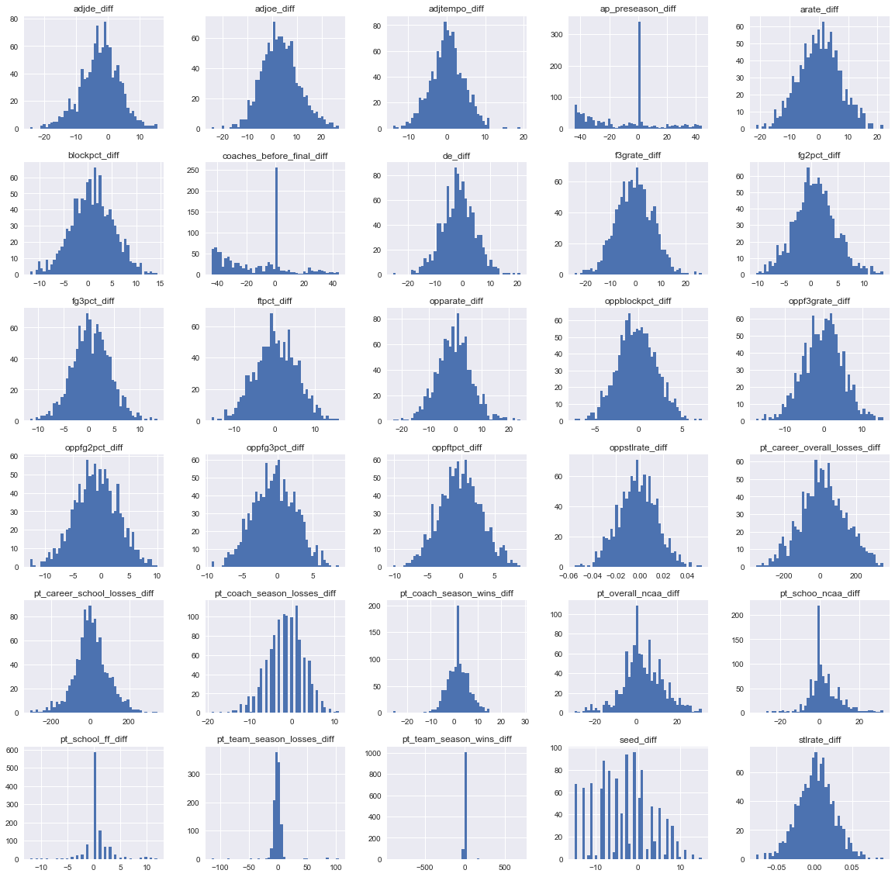
Data Collection and Preprocessing - Difference
Cleaning the data and preparing features for model building
Difference Calculation
For the two competition teams, we obtain the differences for all the corresponding features (for example, diff_feature1 = team1_feature1-team2_feature1), so that we can measure how they differ in terms of all the team features
1
Ratio Calculation
We compute the ratios for the same features between two competition teams (for example, ratio_feature1 =team1_feature1/team2_feature1). By doing so, we construct another set of variables to measure the team features within each historical games
2

Slide 5
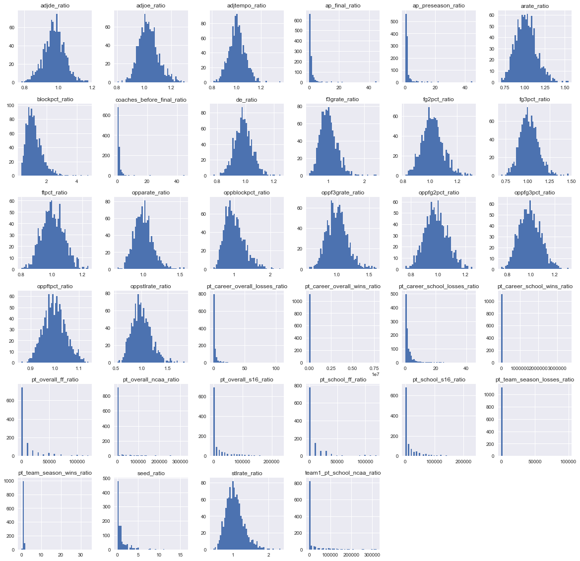
Data Collection and Preprocessing - Ratio
Cleaning the data and preparing features for model building
Difference Calculation
For the two competition teams, we obtain the differences for all the corresponding features (for example, diff_feature1 = team1_feature1-team2_feature1), so that we can measure how they differ in terms of all the team features
1
Ratio Calculation
We compute the ratios for the same features between two competition teams (for example, ratio_feature1 =team1_feature1/team2_feature1). By doing so, we construct another set of variables to measure the team features within each historical games
2

Slide 6
Feature Creation
Factoring-in a new feature to improve the prediction power of the model
New feature: number of NBA draft players
NBA teams conduct annual draft to select players that are outstanding and wish to join the league
The number of NBA draft players within the team indicates how many influential and quality players a team has
Such feature can be added to measure the team potential
Data Collection: Roster list of each NCAA team from 2002 - 2018 & NBA draft player in the list
We web-crawled the roster lists for each competing team from 2002 to 2018 and identified the NBA draft player within the year.
Developed an algorithm to match the team ID in the dataset with the team name on website
Compute the difference between the number of NBA draft players for each set of the competing teams
Feature Insights
Duke has the highest average number of draft players (5.5), followed by Kansas (4.4) then UNC (4.2)
Over 160 teams have contributed their players to the NBA during 2002 to 2018

Slide 7
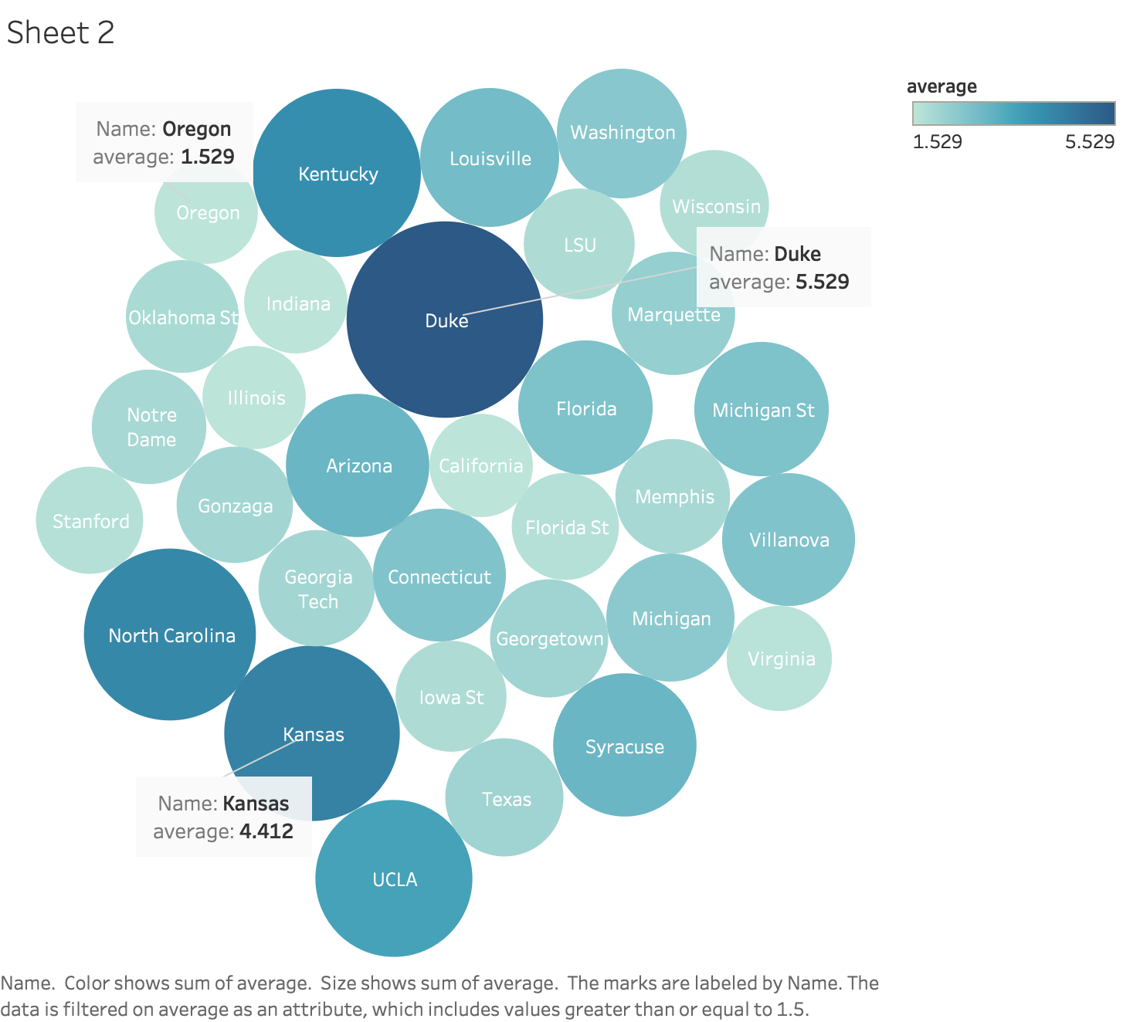
Feature Creation - Average Number of NBA Draft Players
Factoring-in a new feature to improve the prediction power of the model
Average number of NBA draft players from 2002 to 2018

Slide 8
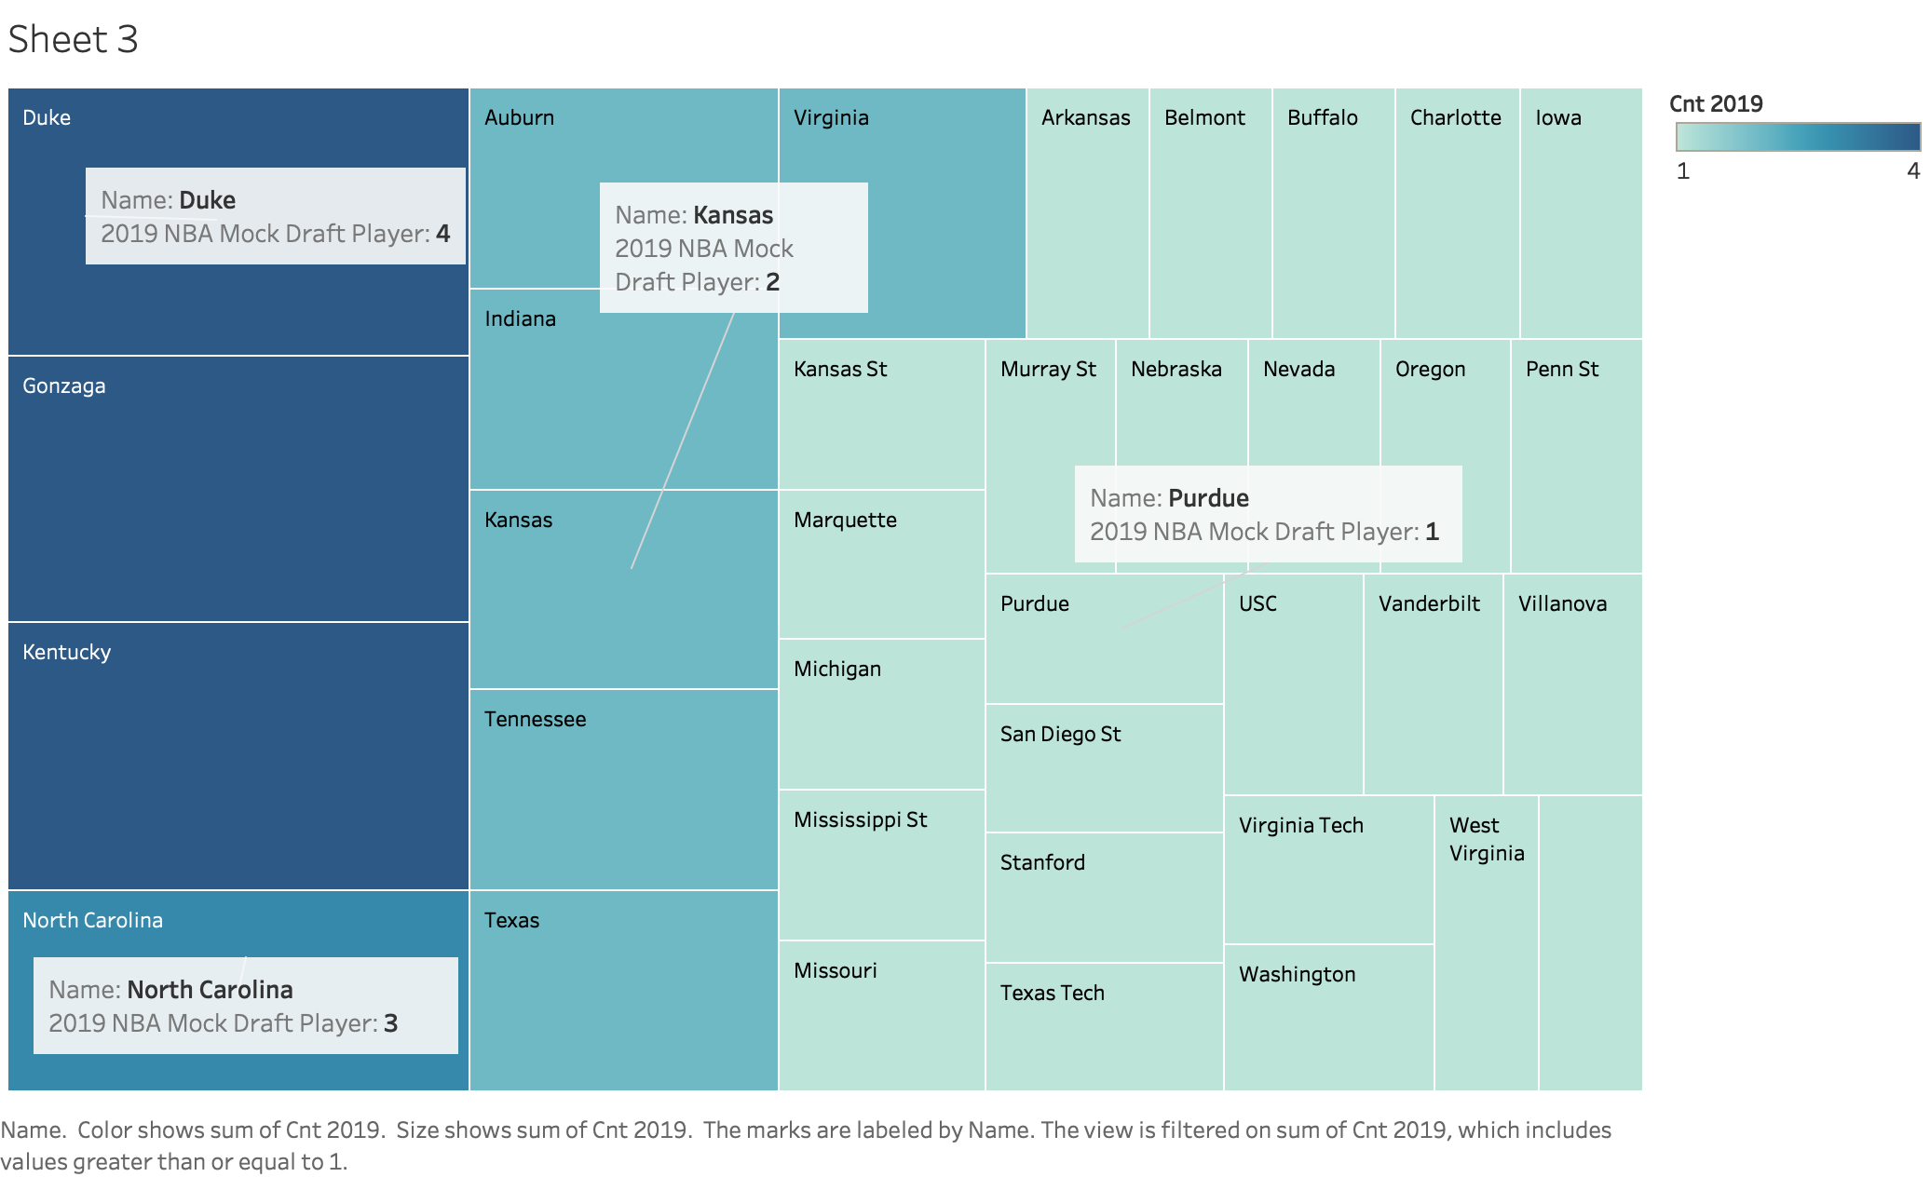
Feature Creation - 2019 NBA Mock Draft Players
Factoring-in new feature to improve the prediction power of the model

Slide 9
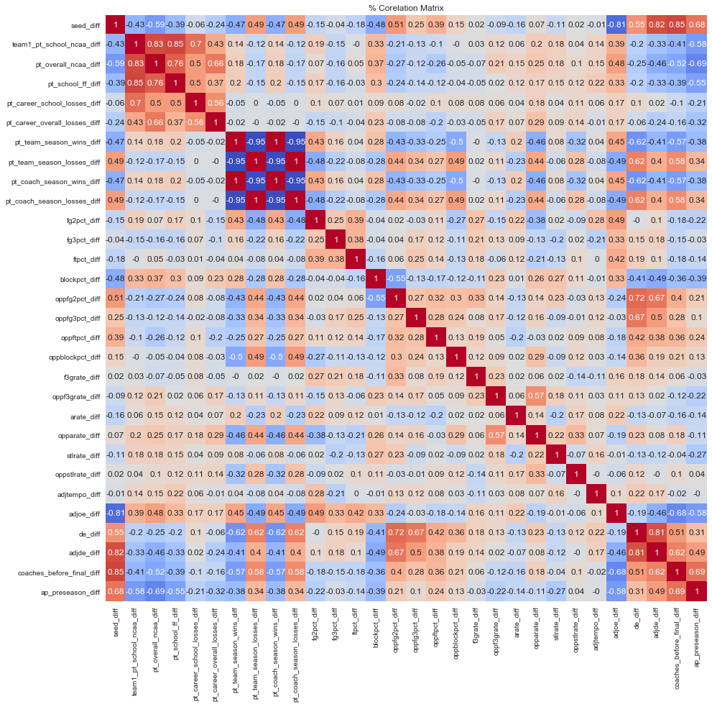
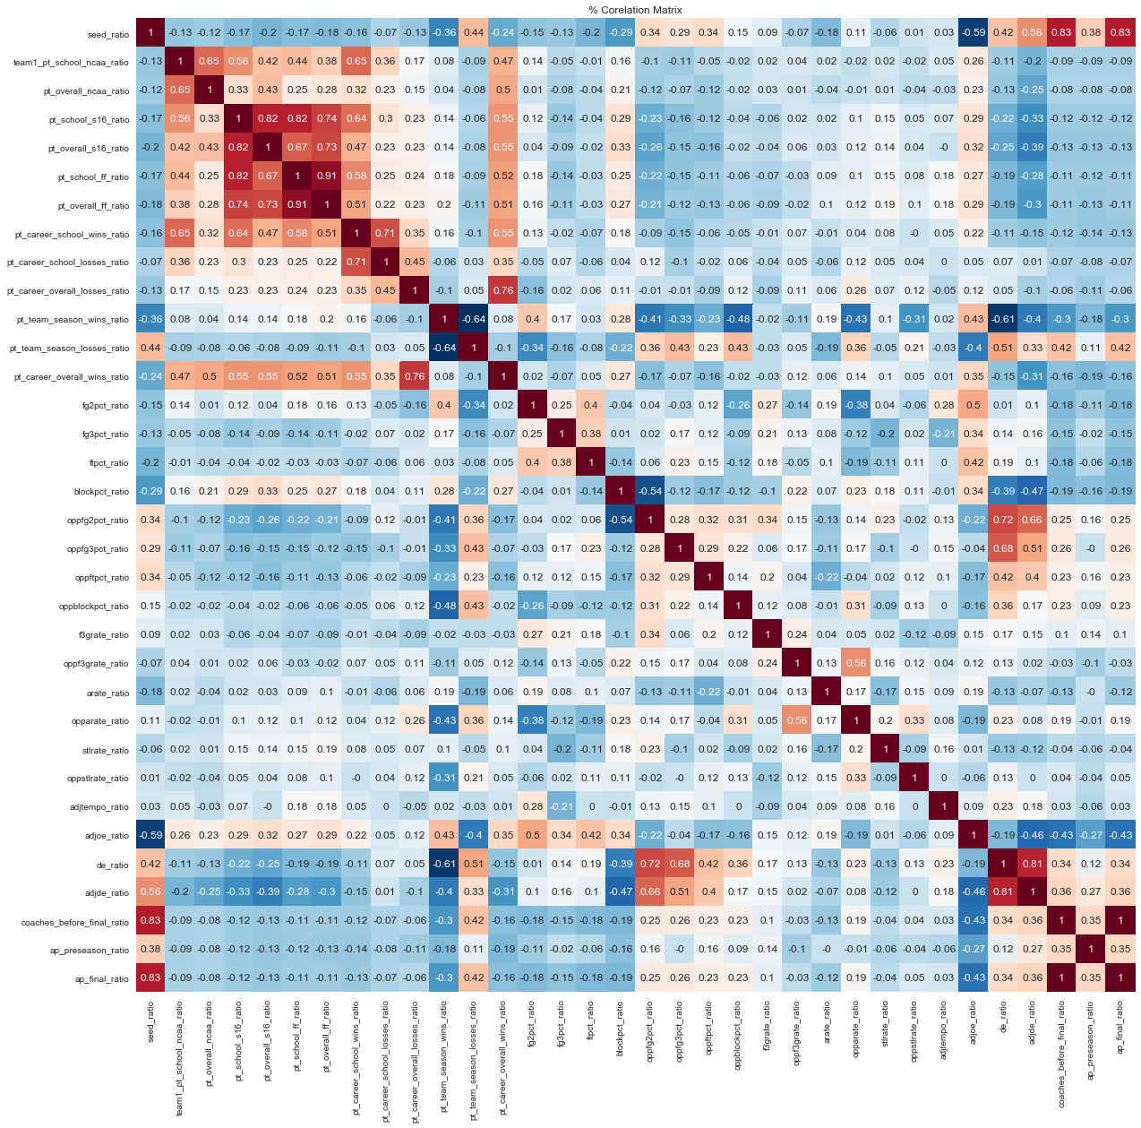
Feature Selection - Difference & Ratio Heatmap
Excluding “overheated” and “heavy blue” features which indicate significant statistical correlations

Slide 10
Model Evaluation
Striking a balance between achieving high accuracy and low log loss
Data preprocessing and feature engineering
Model building using statistical methods and machine learning algorithms
Model evaluation
Construct difference and ratio features
Created new feature to capture the impact of NBA draft players within the team
Conducted feature selection
Training set: match data between 2002 - 2017
Testing set: match data from 2018
Build the following models
Run each model for 200 times and obtain the accuracy and log loss for each time
Plot the average performance for each model to ensure stableness
Select the best-performing model over time
Logistic
Regression
Random
Forest
Support Vector Machine
Linear Support Vector Machine
Gradient Boosting Classifier

Slide 11
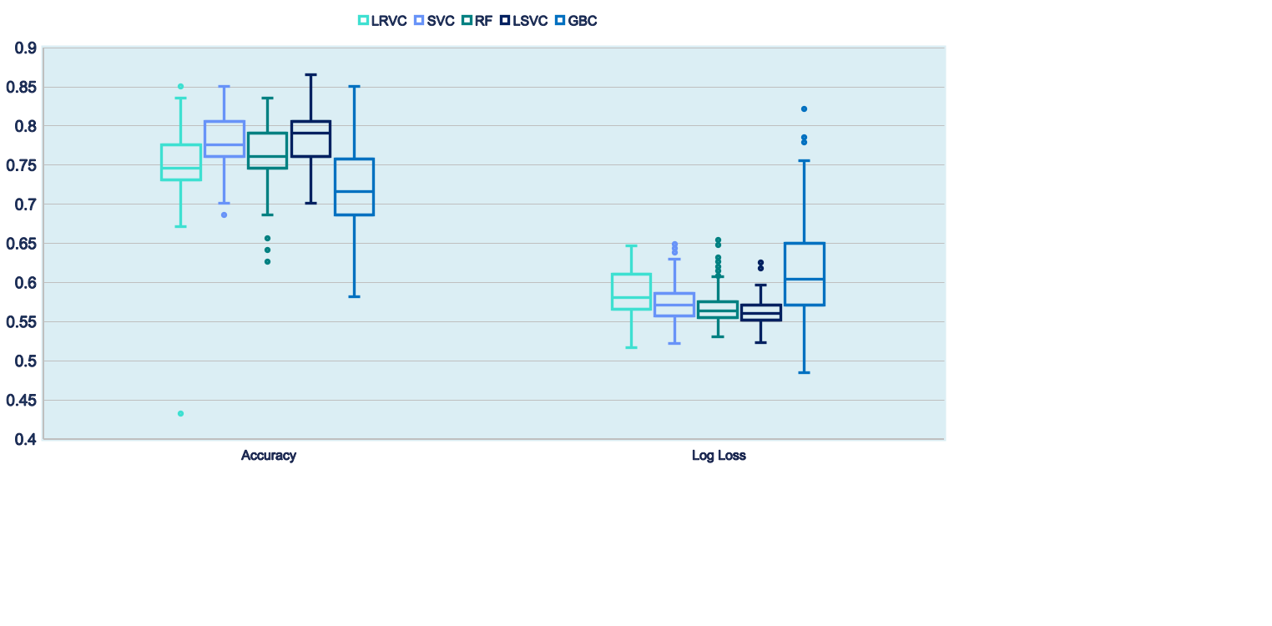
Model Evaluation - Linear SVM Prevails
Striking a balance between achieving high accuracy and low log loss

Slide 12
Final Adjustment
The final step to reduce the log loss
Human intelligence is better than artificial intelligence in general
It is important to also utilize human judgement in building and using models
We adjusted the model probability output as follows:
Wining probability higher than 0.9 → changed to 0.999
Wining probability lower than 0.1 → changed to 0.001

Slide 13
Prediction Results - The Final Four
Striking a balance between achieving high accuracy and low log loss
Duke
Virginia
Gonzaga
Kentucky

Slide 14
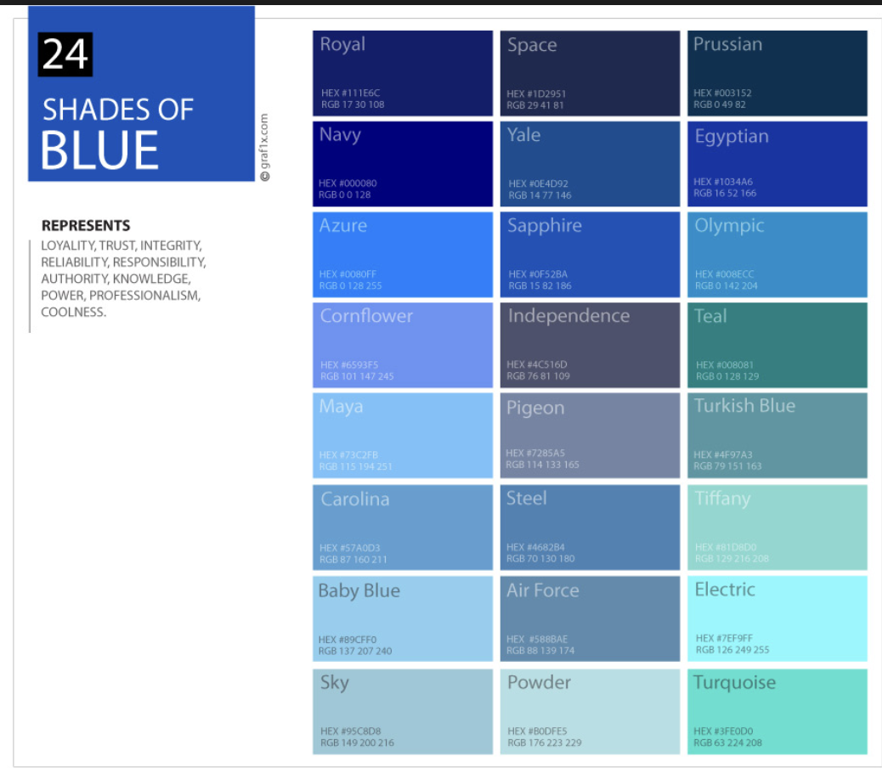
Key Takeaways
Highlighting the unique features of our methodology and prediction results
Feature Creation
Added a new factor - no. of NBA draft players, which may potentially affect the overall team performance during the match
Web-scraped the roster list from 2002 - 2018 for each competing team to construct the new feature
Model Selection
Ran 5 statistical/machine learning models for 200 times each with random sampling to measure the overall accuracy and log loss of each model
Selected the best-performing model - Linear Support Vector Machine (accuracy: 0.79 log loss: 0.56)
Final Adjustment
Adjusted the match wining probability for those higher than 0.9 and lower than 0.1
Applied human judgement on top of the machine learning results
Ability to achieve low log loss compared with other models

Slide 15
The End

